Slide 1
How to use code::blocks to compile multiple files?

Slide 2
Using Header Files
Note that in the standard C library
I/O function prototypes placed in stdio.h
math function prototypes placed in math.h
Create your own header file, and place function prototypes and defined constants in it.
Create a project in your IDE compiler, and put the source .c files into the project.
Compile the project

Slide 3

Example
Create a new project.

Slide 4
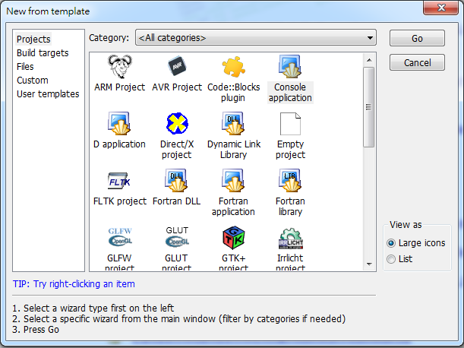
Example
2
1

Slide 5
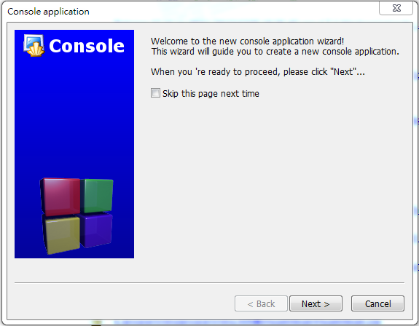
Example

Slide 6
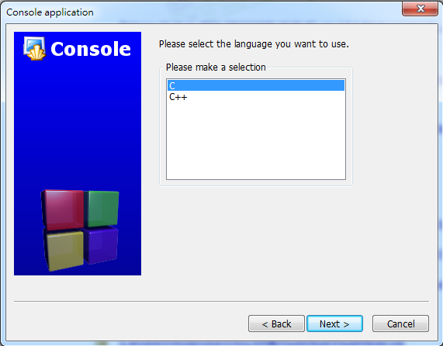
Example
1
2

Slide 7
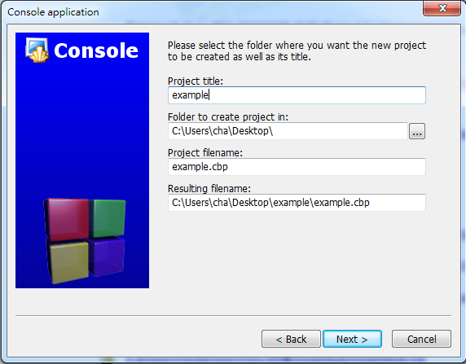
Example
←1: enter your project title
←2: select your project path
3

Slide 8
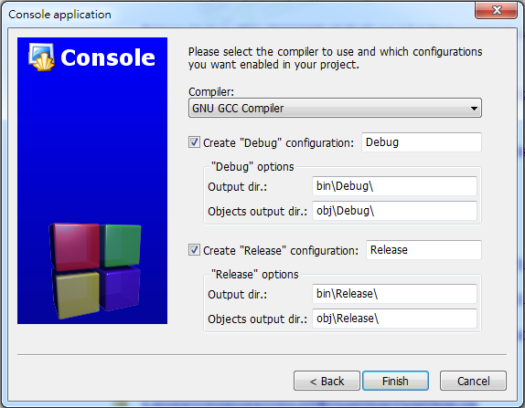
Example

Slide 9
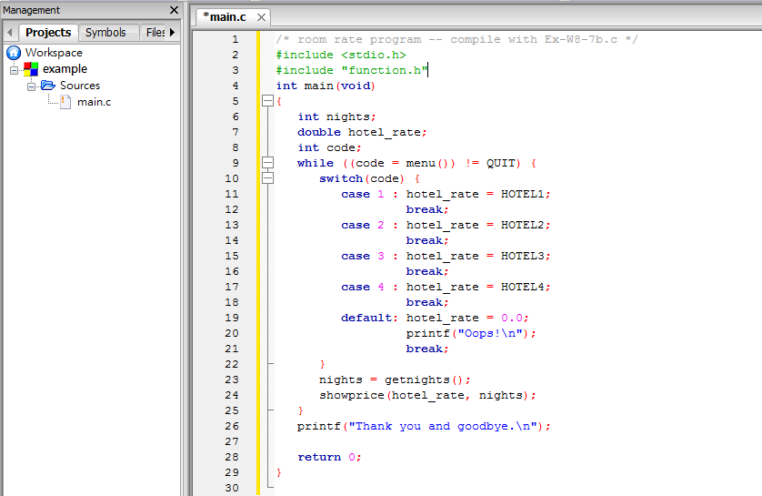
Example
main.c: place your main function here.

Slide 10
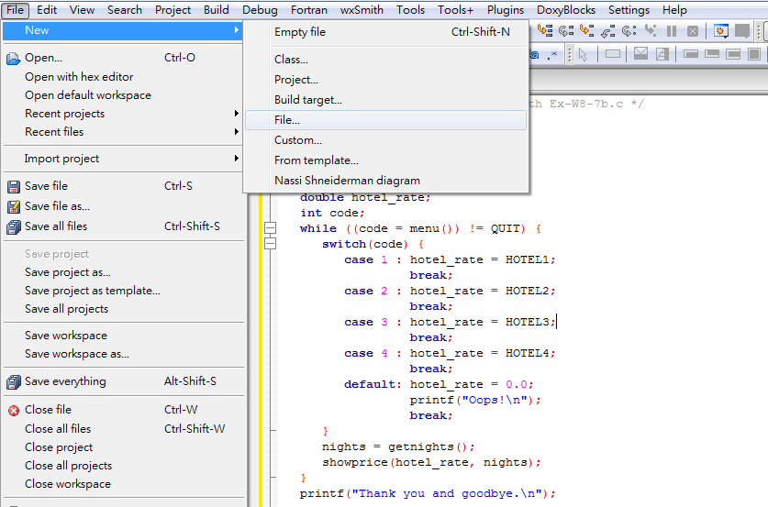
Example
Add a new header file.

Slide 11
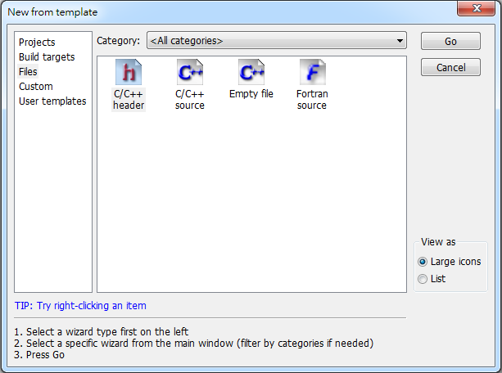
Example
2
1

Slide 12
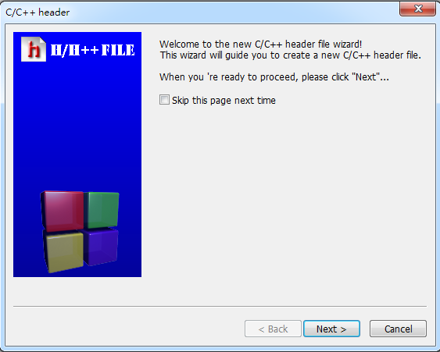
Example

Slide 13
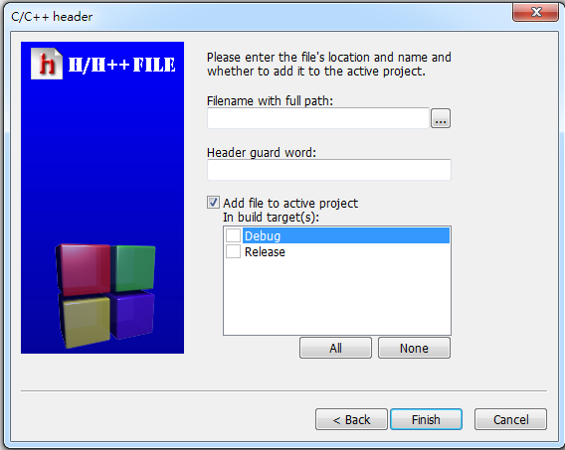
Example
←select your project path

Slide 14
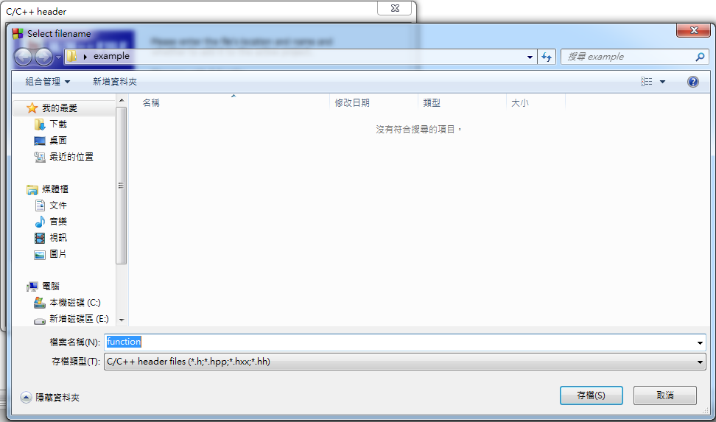
Example
←1:enter the filename of your header file
2

Slide 15
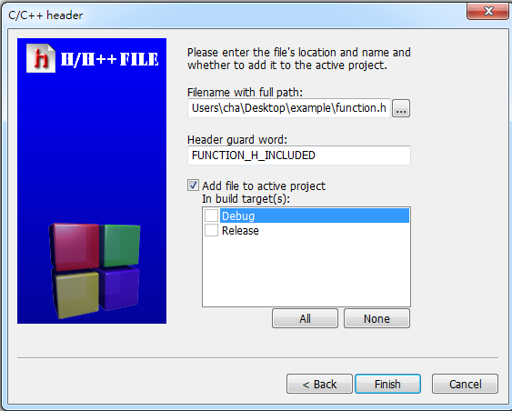
Example

Slide 16
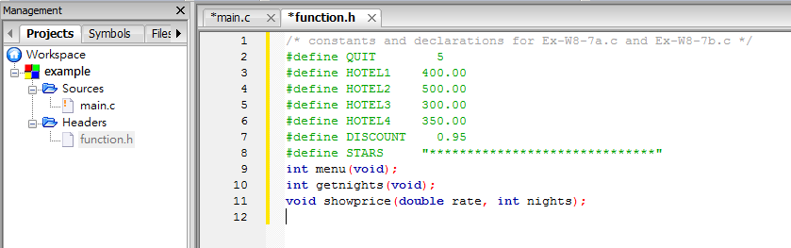
Example
function.h: place function prototypes and defined constants here.

Slide 17
Example
Add a new C source file

Slide 18
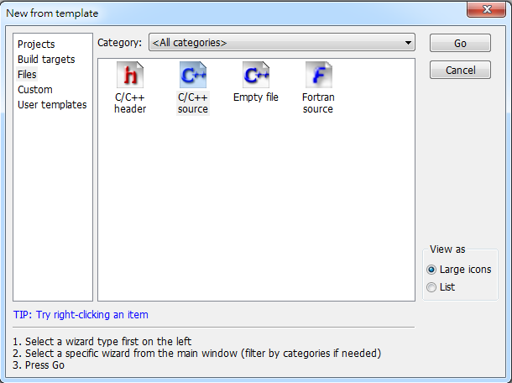
Example
2
1

Slide 19

Example

Slide 20
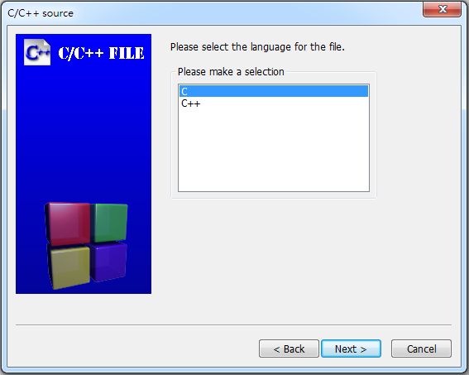
Example
1
2

Slide 21
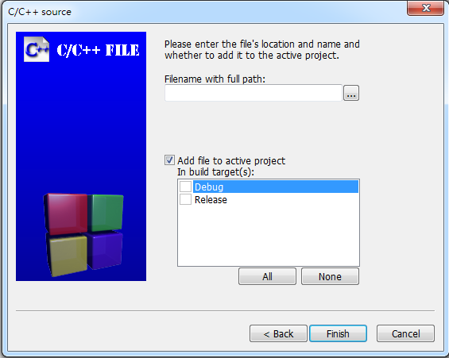
Example
←select your project path

Slide 22
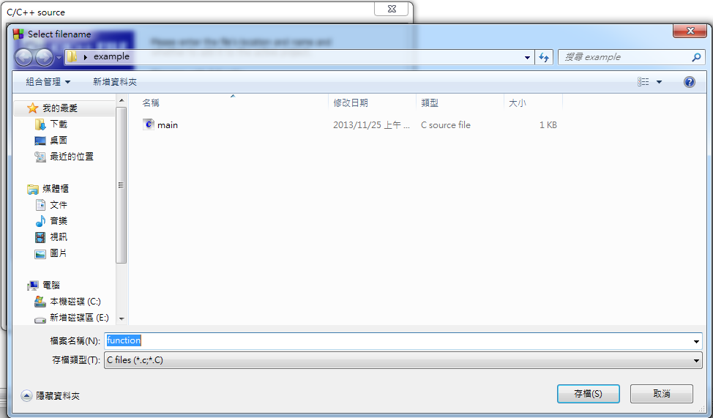
Example
←1:enter the filename of your source file
2

Slide 23
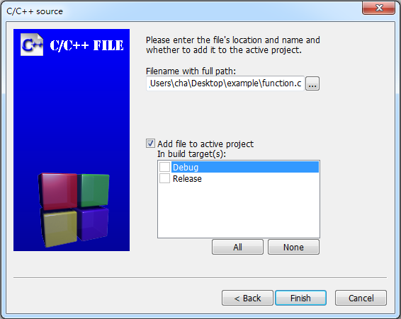
Example

Slide 24
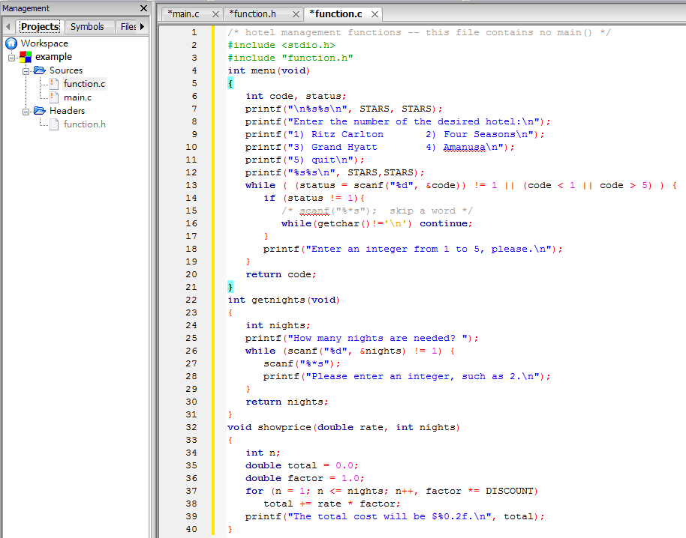
Example
function.c: implement the functions which are defined in the file function.h
←Don’t forget to include function.h

Slide 25
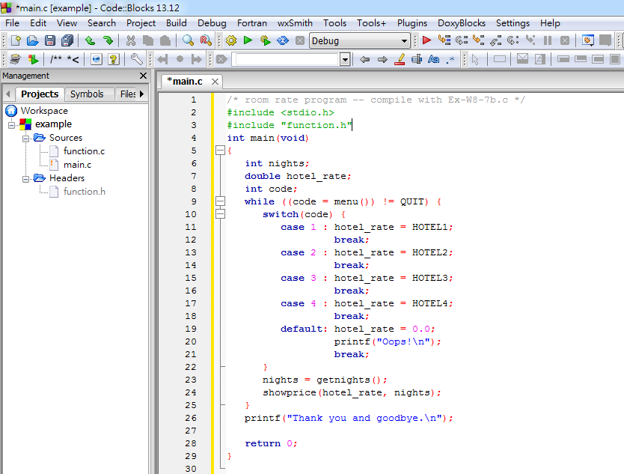
Example
Build and run the project.

Slide 26
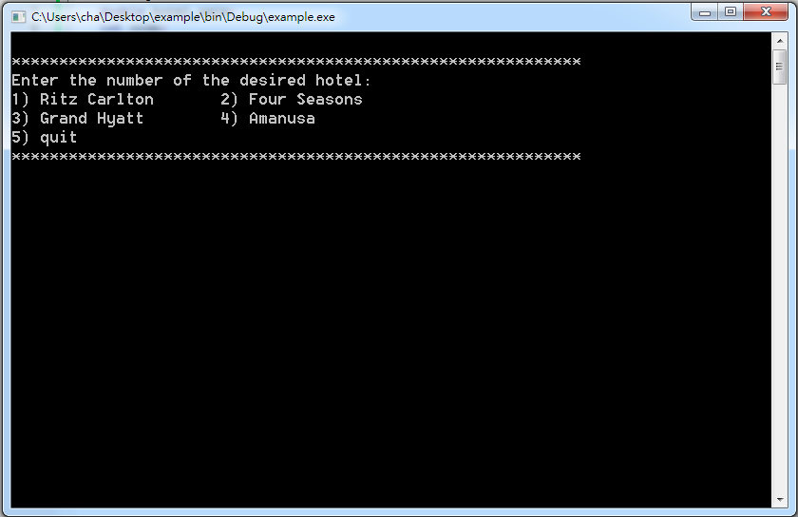
Example

